Slide 1
3D Gaussian Splatting Representation Compression
Presenter: Eren Çetin
Supervisors: Dr. Ertunç Erdil
Yannick Strümpler
Dr. Ender Konukoğlu
Notes:
Good afternoon everyone.
My name is Eren, and today I will introduce my semester project on 3D Gaussian Splatting Representation Compression, under the guidance of Dr. Ertunç Erdil, Yannick Strümpler, and Dr. Ender Konukoğlu.
Our purpose with this project is to achieve a compressed representation for 3D Gaussian splatting which was relatively recently introduced.

Slide 2
Outline
Background 🖼️
3D Gaussian Splatting
MCMC Framework
Context and Motivation 🛣️
Avenues for Compression
Methodology 🧪 ➕ Results 📝
Gaussian Primitive Pruning
Learned Entropy Modeling
Multi-rate Entropy Modeling
Key Takeaways 💯
Notes:
For the overview of this presentation, I will walk us first through a brief background on novel view synthesis, proposition of 3D Gaussian splatting and the operational details of it.
Then we will go over why compressing the Gaussian splatting representation is actually an important problem and how it can be achieved.
Finally, I will introduce our methodology for this goal and the results that are collected throughout the timeline.
At the end, I will talk about the key takeaways from this project and take your questions.

Slide 3
🖼️ Background
Notes:
So let’s start with the background information

Slide 4
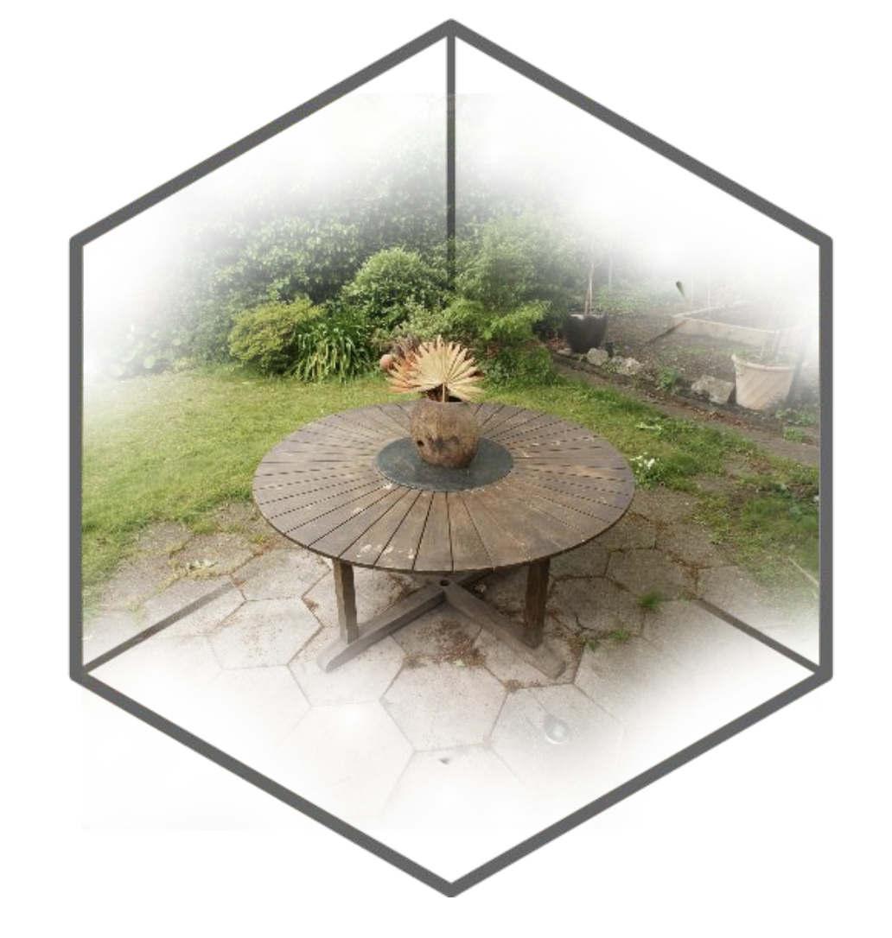
3D Gaussians form a representation for radiance fields
Shahbazi et al. “InseRF: Text-Driven Generative Object Insertion in Neural 3D Scenes”
Goal: Reconstruct novel views of a 3D world using a set of images with given camera parameters
Needs to be
Fast
Accurate
Practical to integrate
Memory efficient
Notes:
Our goal with 3D gaussian splatting is novel view synthesis for a 3D space by using a set of images with given camera parameters.
As requirements from such novel view synthesis methods, we want to ensure that the process is fast, accurate, practical to integrate, and memory efficient.

Slide 5
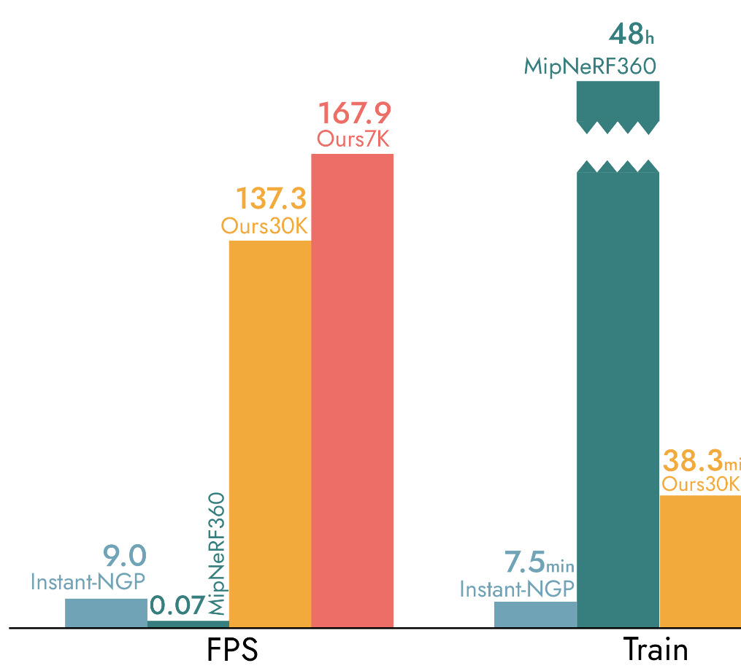
While Gaussian splatting is fast 💨
3D Gaussian Splatting for Real-Time Radiance Field Rendering
3D-GS
3D-GS
FPS
Training duration
Notes:
As a big plus for Gaussian splatting, it is really fast.
Compared to the relatively long training and rendering duration offered by NeRFs, 3D-GS achieves a superior rendering speed and a much shorter training duration
That is mainly because, 3D Gaussian Splatting is based on fast parallelizable rasterization, offering real-time rendering.
Now let’s go into details of how 3D Gaussian splatting achieves this rendering speed and what is the catch with it

Slide 6
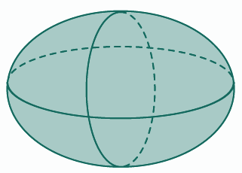
Main building block of Gaussian splatting: Gaussians
Gaussians are composed of
Position, μ
Covariance, Σ
Opacity, o
Color, c
Gaussians are composed of
Position, μ
Scaling, S
Rotation, R
Opacity, o
Spherical Harmonics, SH
μ
S, R
o
SH
positive semidefinite constraint with
view dependent color
Notes:
As the name implies, Gaussian splatting builds an explicit scene representation using millions of 3D Gaussians.
and
These parameters are optimized throughout the training to achieve a better scene representation.
Gaussians have position, covariance, opacity and color attributes.
To enforce positive semidefiniteness of covariance matrix, it is split into scaling and rotation parameters. Scaling parameters represent the extent of Gaussians, and rotation parameters represent the direction of Gaussian.
In addition, the view dependency of color is modeled using spherical harmonics.
For a compact representation, the rotation is represented with a quaternion vector with 4 scalar values.
The spherical harmonics allow us to represent any function on a sphere as the sum of simpler basis functions (much like a Fourier series!). As a result, we get view-dependent color changes for each Gaussian and a final explicit scene representation composed of all Gaussians.

Slide 7
We the Gaussians from 3D to 2D
splat
3D Gaussian primitives have desired properties for scene representation and rasterization:
Creates smooth renderings
Provides compact and scalable representations
Avoids unnecessary computations in empty space
Notes:
To rasterize a view, we “splat” the Gaussians from 3D to 2D, creating smooth and compact representations while avoiding unnecessary computations.
Knowing the camera parameters, we project the ordered Gaussians’ mean, and covariance from 3D to 2D and then apply alpha blending based on the Gaussian densities, opacities, and view-dependent colors.
This process allows for fast rasterization and avoids unnecessary computations in empty space, making it efficient.
This whole process is highly scalable and parallelizable since the Gaussians are independent from each other, allowing for parallel evaluation and the rasterization can be performed in parallel for each pixel as well.
So first, for each pixel, we calculate the density function for every Gaussian that is penetrated by the ray forming the pixel. Then, we perform alpha blending based on the view-dependent color which is calculated by evaluating the spherical harmonics based on the view angle. To perform the alpha blending, the Gaussian primitives are sorted based for 16x16 tiles for efficiency.

Slide 8
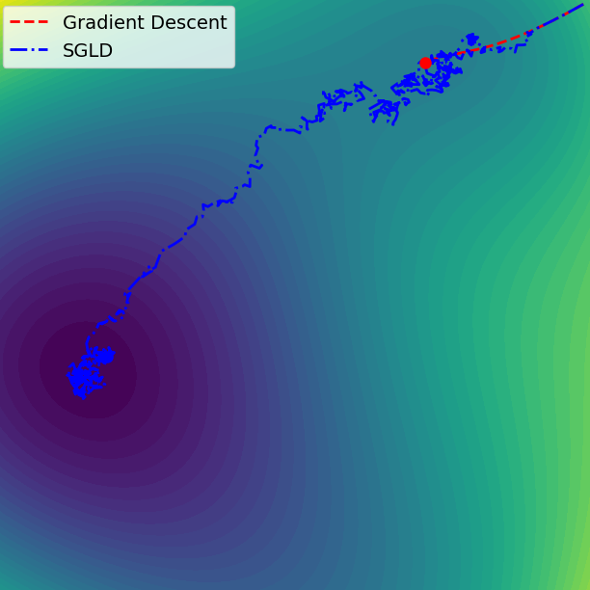
SGLD improves exploration during optimization
Kheradmand et al. “3D Gaussian Splatting as Markov Chain Monte Carlo”
Use Stochastic Gradient Langevin Dynamics to optimize Gaussian positions, μ
Use regular Gradient Descent for rest of the Gaussian attributes
Refine the loss function with additional regularization
Notes:
The whole rasterization pipeline is designed in a differentiable way so that we can perform gradient descent over rasterized images.
As an improved version of the seminal Gaussian splatting optimization pipeline, we use a noisy exploration with Stochastic Gradient Langevin Dynamics.
Specifically, for Gaussian positions, we use SGLD and induce noise to better explore the scene.
For rest of the parameters, regular Gradient Descent is used.
In addition, loss function is further regularized with opacity and eigenvalues of the covariance matrix to encourage using fewer Gaussians
(lower opacity and scale essentially transfer to fewer Gaussians)

Slide 9
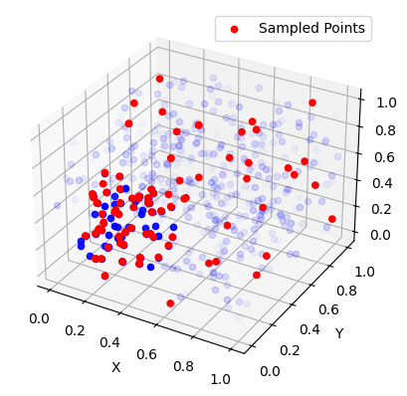
MCMC Framework improves optimization
Kheradmand et al. “3D Gaussian Splatting as Markov Chain Monte Carlo”
Add new Gaussians only 5% at every 100 iterations until a maximum number
New Gaussians are “cloned” using a multinomial distribution proportional to the opacity of existing Gaussians
Remove dead Gaussians with very low opacity
Dead Gaussians are “teleported” to live Gaussians using a multinomial distribution proportional to the opacity of live Gaussians
Notes:
In addition, new Gaussian primitives are added with an MCMC framework during the optimization process.
New Gaussians are added based on the opacity of existing Gaussians using a multinomial distribution.
And dead Gaussians with an opacity lower than 0.005 are teleported to the location of live Gaussians using the same multinomial distribution.

Slide 10
👨‍🏫 Context and Motivation

Slide 11
Gaussian splatting can synthesize novel views fast 🏃‍♀️‍➡
Kerbl et al. “3D Gaussian Splatting for Real-Time Radiance Field Rendering”
Notes:
All has been well until this point: Gaussian splatting is super fast, and optimization is feasible

Slide 12
But it requires a large storage capacity 💿
59 scalars
3 scalars
3 scalars
4 scalars
48 scalars
1 scalar
1M Gaussians
~
225 MB
How can we reduce the storage complexity ❓
Notes:
But it also creates too many Gaussian primitives.
Each Gaussian has 59 scalar parameters, majority coming from spherical harmonics.
As an example, a scene with a modest 1M Gaussians requires around 225 MB storage space.
So this brings us to our question of: “How can we reduce the storage complexity?”

Slide 13
There are 3 main avenues to reduce storage complexity
Notes:
With this question in our mind, we realize that there are 3 main avenues for this goal.
The first one is reducing the number of Gaussian primitives because every scene requires a very large number of Gaussian primitives and the optimization process of 3D Gaussian splatting creates many redundant Gaussians.

Slide 14
There are multiple avenues to reduce storage complexity
Notes:
The second one is through reducing the precision of Gaussian attributes to require a smaller space per attribute

Slide 15
There are multiple avenues to reduce storage complexity
Notes:
And the last one is compressing the Gaussians in a more efficient manner so that the bitrate overhead is lower thanks to a better entropy model for the Gaussian attributes.

Slide 16
There are multiple avenues to reduce storage complexity
2️⃣ Secondary target
❌ Not in scope
1️⃣ Primary target
Notes:
For a feasible approach, we decided to focus on reducing number of Gaussians and also compressing them with better entropy modeling instead of reducing their precision.

Slide 17
🧪 Methodology & Results 📝
Notes:
Now, let’s continue with our methodology through those avenues

Slide 18
Our first step is pruning redundant Gaussians
Niemeyer et al. “RadSplat: Radiance Field-Informed Gaussian Splatting for Robust Real-Time Rendering with 900+ FPS”
Apply “RadSplat pruning” twice during optimization to reduce number of Gaussians
Calculate pixel contribution of Gaussians over all training data,
Threshold the maximum contribution of Gaussians to remove ineffective ones
Repeat pruning at 16K and 24K iterations before completing optimization at 30K
Notes:
As the first step of our methodology, we aim to remove the redundant Gaussians. We evaluated multiple methods for that and decided on a pruning method suggested in RadSplat.
Accordingly, we remove Gaussians twice throughout the 30K iterations of our training.
As a reminder, here is how we calculate a density for each Gaussian primitive. As a first step we calculate the pixel contribution of each Gaussian as a proxy of the importance of each Gaussian over all pixels and all images in our training set. Then we take the maximum contribution for each Gaussian and remove ones with a contribution below a predefined threshold.
Although this operation is slightly expensive because it requires to calculate the contribution over many views, we only apply it twice and use CUDA acceleration in a similar fashion to rasterization which results in a simplistic and light-weight operation overall.

Slide 19
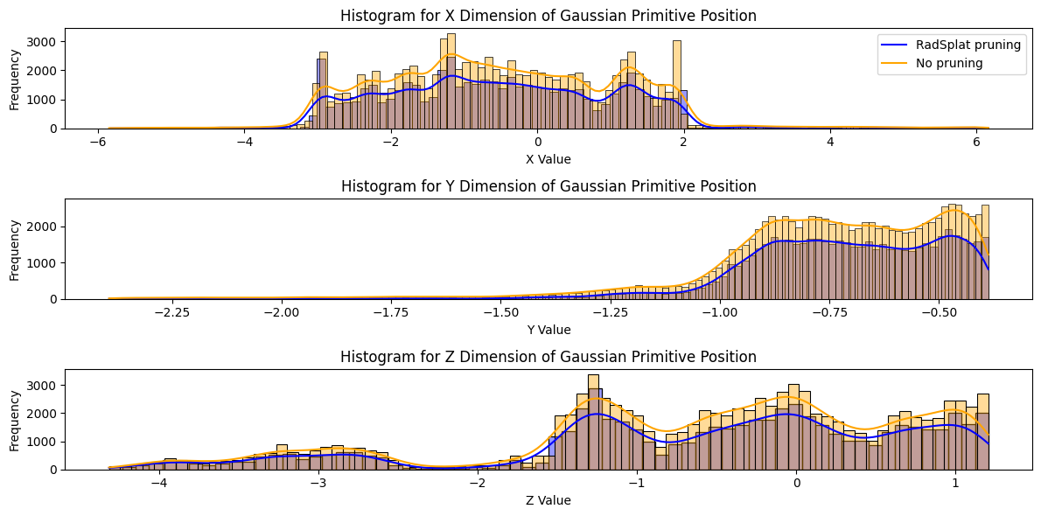
Pruning removes mostly from over-represented regions
Pruning considers the contribution of Gaussians, providing a good heuristic for importance
Notes:
Firstly, let's analyze the change in the number of Gaussians after applying pruning.
Here we see the distribution of Gaussians with and without applying pruning. The blue bars and the kernel density estimation represent the Gaussian distribution after pruning and orange bars and kernel density estimation represent no pruning.
As we can see, the pruning is more aggressive at regions where there are a lot of Gaussians and the pruning removes excess ones with a low maximum contribution.
In addition, note that reducing the number of Gaussians also translates into a faster rasterization due to reduced computation complexity.

Slide 20
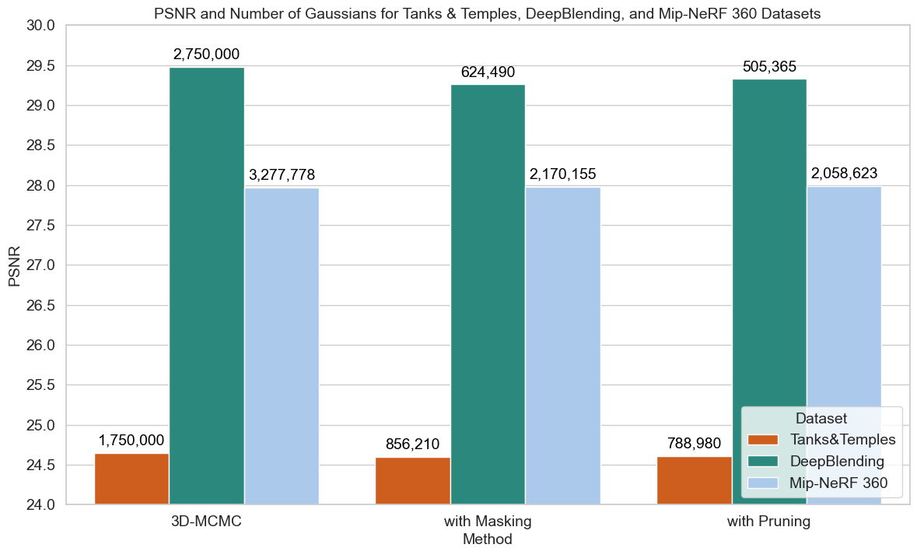
Effect of pruning on visual quality is negligible
Notes:
Secondly, let’s view the effect of pruning in terms of quantitative visual quality with PSNR values on Tanks & Temples, DeepBlending, and Mip-NeRF 360 datasets.
The numbers on bars show the average number of Gaussians on full test evaluations while the bar heights show the PSNR values. We evaluate against another method which applies learned masking on Gaussians to reduce number of Gaussians. Based on our observations, the pruning method we opt for achieves a higher reduction with negligible degradation in visual quality.

Slide 21
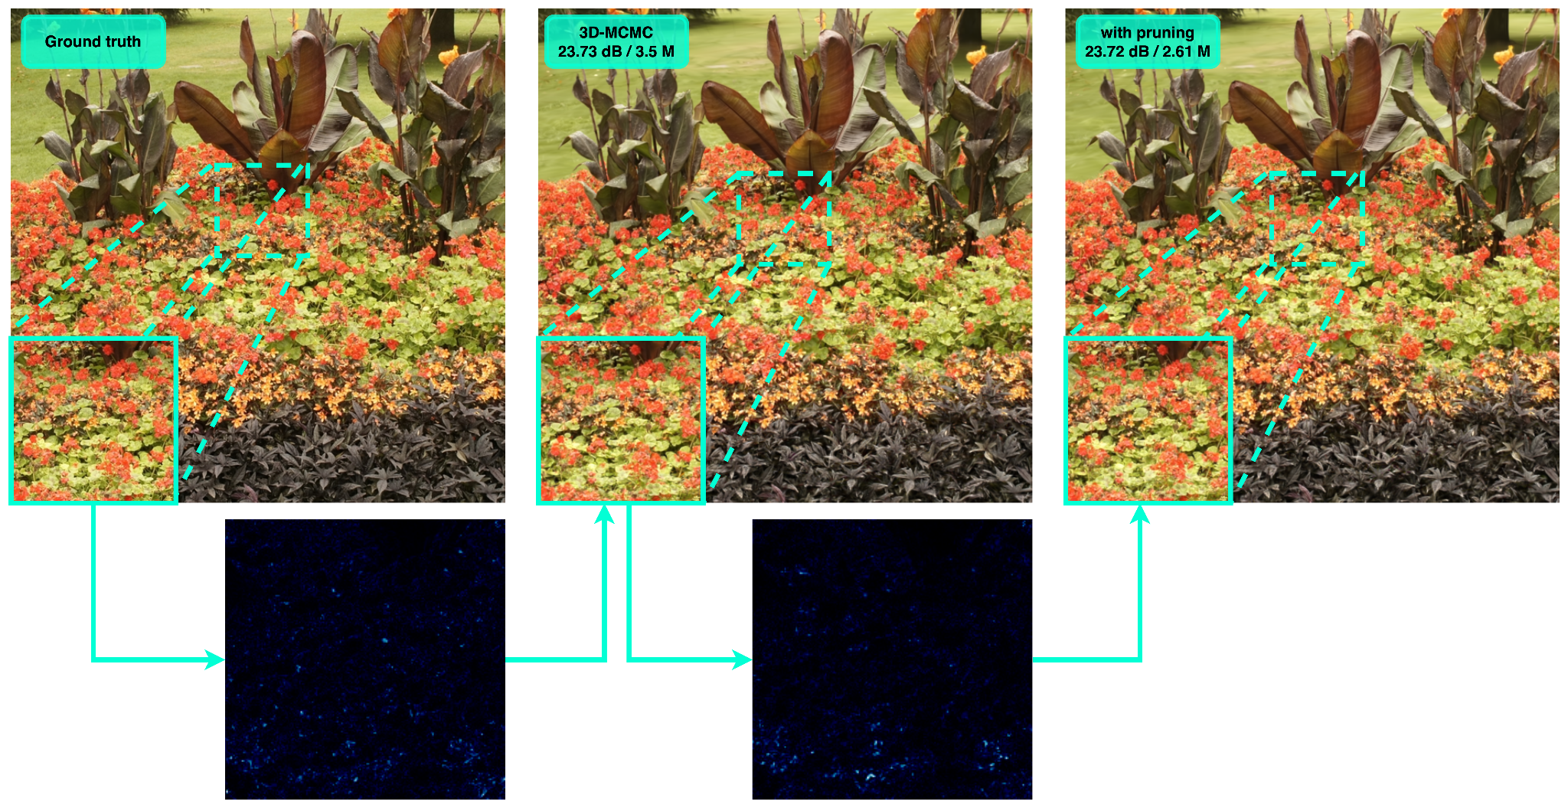
Effect of pruning on visual quality is negligible
Mip-NeRF 360 / flowers
MAD: 12.04
MAD: 7.34
Notes:
Lastly for pruning we check a qualitative comparison on flowers scene from Mip-NeRF 360 as it has fine details. When we compare the tiny crops, the fine details still remain before and after applying pruning. The change in rendered residual frames is comparably small while the mean absolute difference is relatively small and not affecting visual quality.

Slide 22
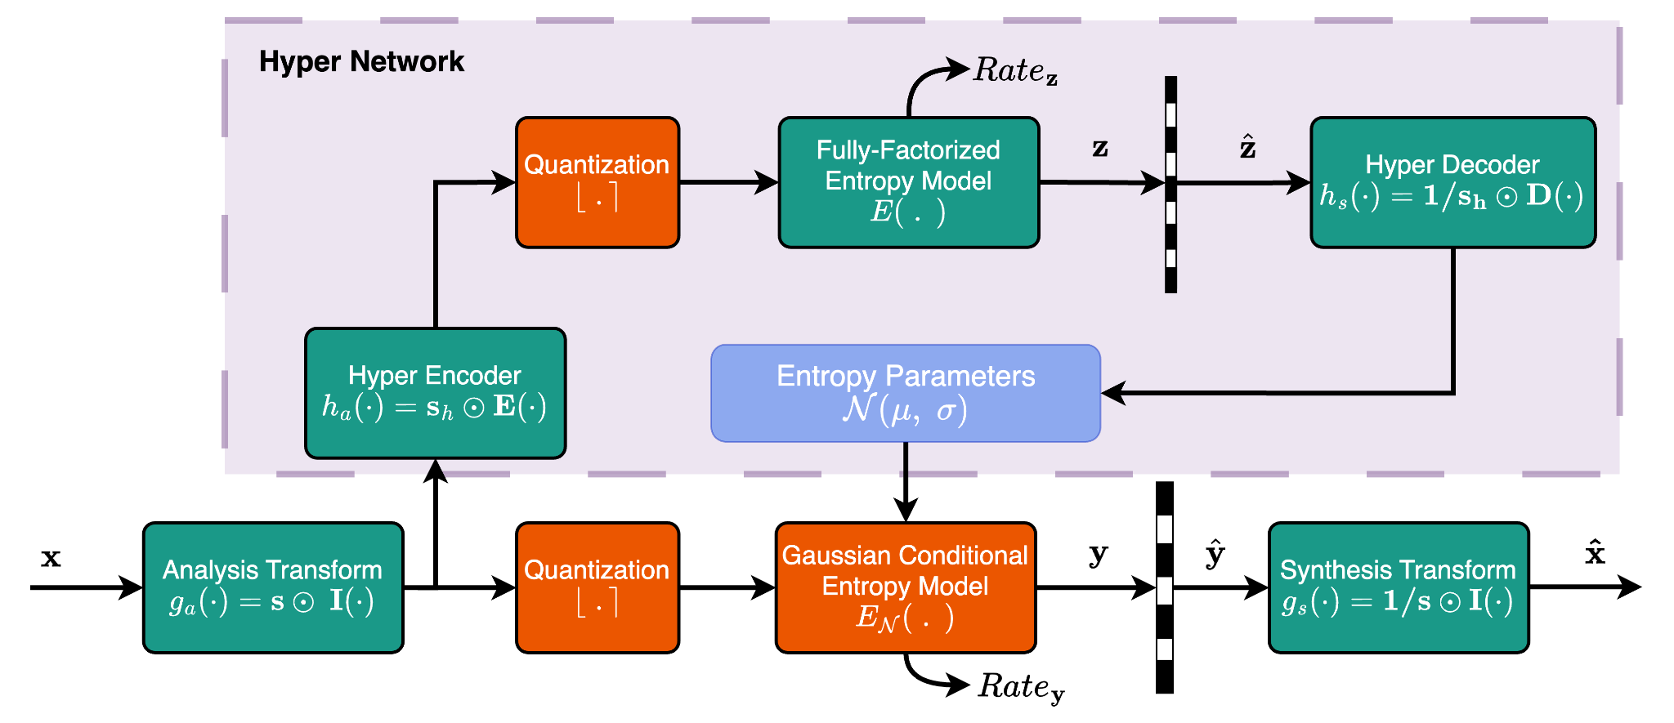
Our second step is learning entropy model for coding
Learn an accurate probability distribution over Gaussian parameters to reduce bitrate overhead
Notes:
As the second step of reducing the storage complexity, we use a hierarchical learned entropy model which was shown to achieve great success in image/video compression literature.
In this diagram, the green boxes depict the learned components and orange boxes depict the fixed operations.
Now let’s go over the mechanism of compression with this hierarchical learned entropy model and its training.

Slide 23
First we scale the Gaussian attributes
Scale Gaussian attributes to prevent over-distorting important ones
❗️Position μ is compressed
using DEFLATE algorithm
Notes:
As a first step, the input features: scaling, rotation, opacity and spherical harmonics are concatenated to each other and scaled with learned scale parameters which compose our analysis transform. This is just an elementwise multiplication. We decided to exclude position attributes because they are most sensitive to compression noise. We compress positions using DEFLATE algorithm which essentially performs Huffman coding.

Slide 24
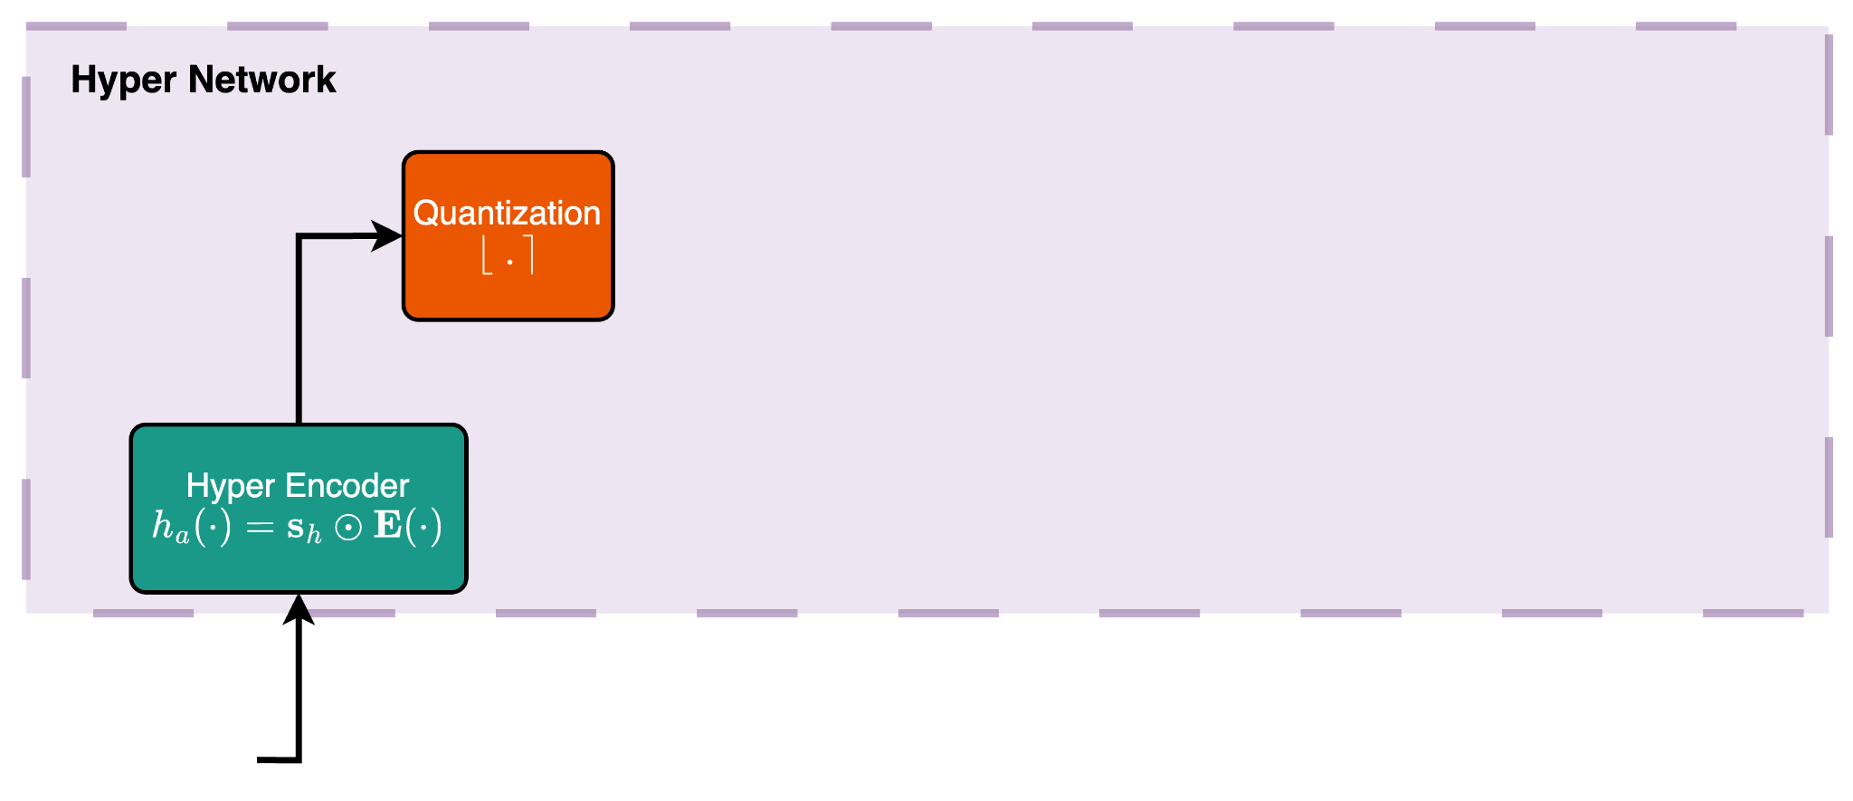
Our second step is learning entropy model for coding
Encode Gaussian attributes, scale and quantize to form latent representation for entropy parameters
Notes:
After the analysis transform with scales, the scaled attributes are passed to a hyper network which is essentially an autoencoder. Its goal is to calculate the entropy parameters of the scaled attributes and pass the latent representation required for decoding to the decoder. It has a lightweight encoder and decoder which are just 3-layer MLPs.
In a similar fashion to the main backbone, we scale the encoded latent representations and then apply quantization prior to entropy coding.

Slide 25
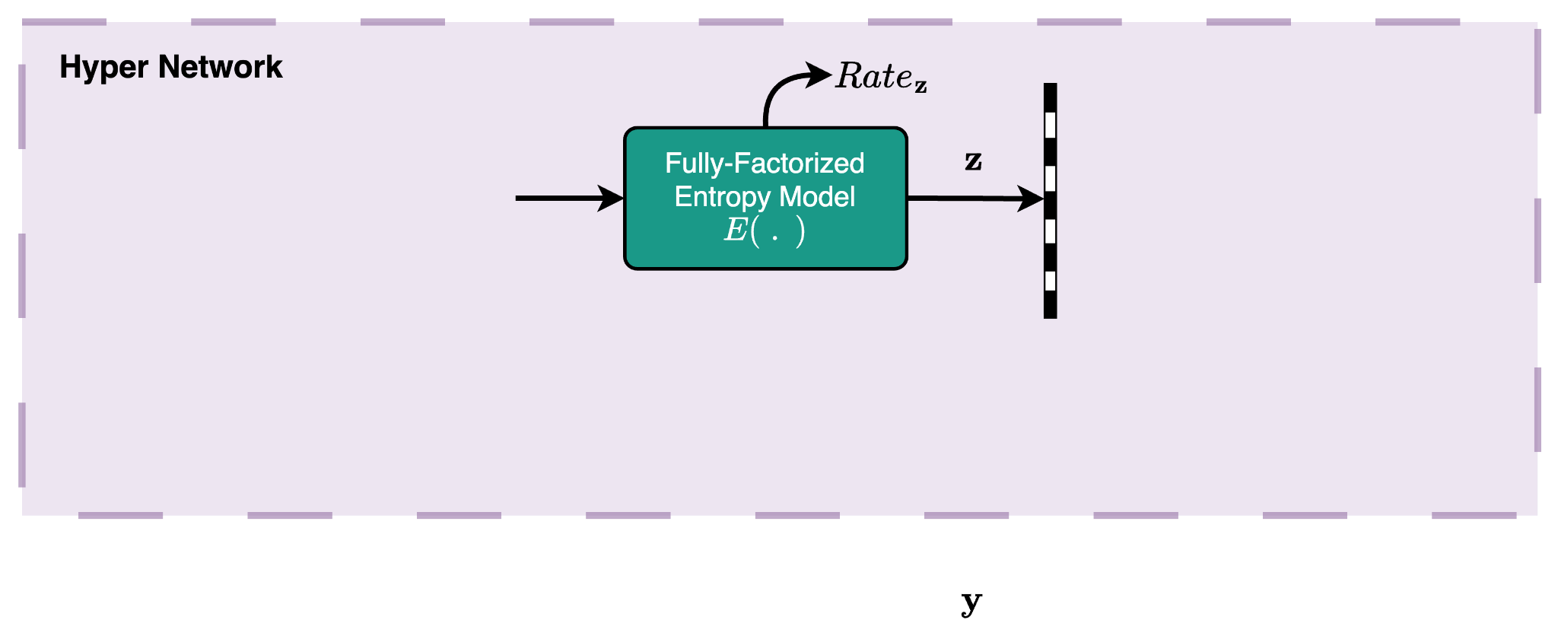
Our second step is learning entropy model for coding
Compress latent entropy parameters into a bitstring as side information for Gaussian attributes
Notes:
To apply entropy coding on the latent entropy parameters, we use a fully-factorized entropy model which is a 4-layer neural network designed to model the CDF of the latent representation z. Using the modeled CDF, we can differentiate it and calculate the PDF for entropy coding.
After performing entropy coding, the bits are sent to the decoder

Slide 26
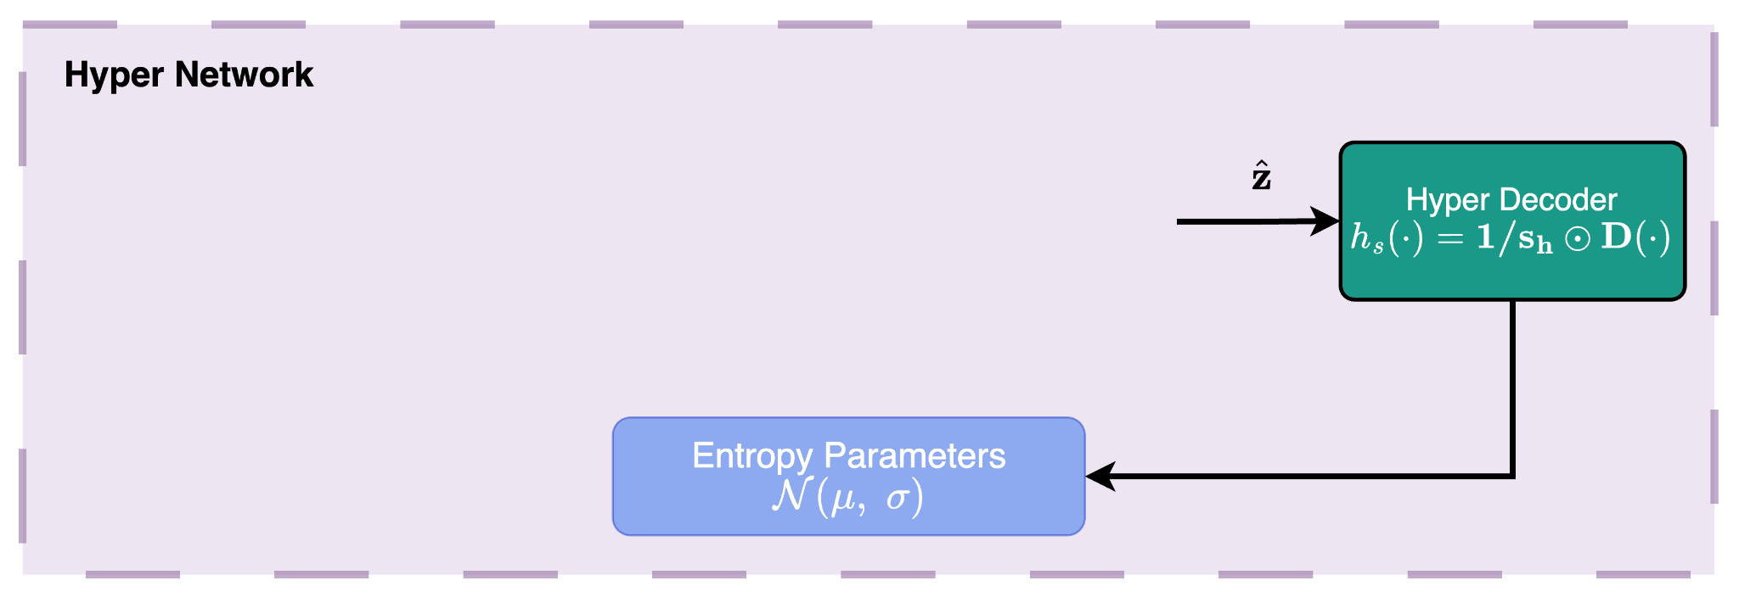
Our second step is learning entropy model for coding
Decode latent entropy parameters for entropy coding of Gaussian attributes
Notes:
The hyper-decoder then decodes the latent representation and rescales to retrieve the entropy parameters of actual Gaussian attributes.
These parameters are essentially one mean and one standard deviation per each Gaussian attribute which help us to model the distribution of Gaussian attributes as a Gaussian conditional.

Slide 27
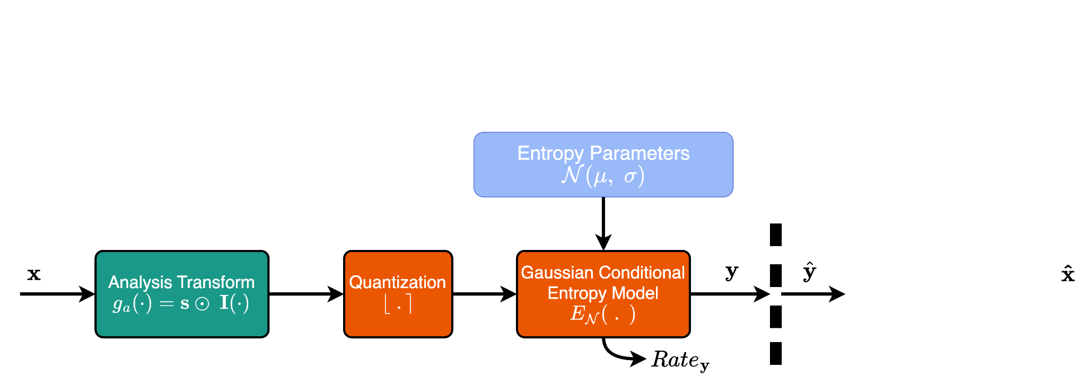
Our second step is learning entropy model for coding
Scale, quantize and encode Gaussian parameters into a bitstring
Notes:
As we now calculated the entropy parameters for the Gaussian conditional entropy model, we can compress the scaled attributes and send them to the decoder side

Slide 28
Our second step is learning entropy model for coding
Decode and rescale Gaussian attributes
Notes:
Finally, the decoder decodes the encoded representation using the calculated entropy parameters, and the compressed representation of Gaussian attributes. It then reverts the scaling that was applied at the analysis transform.
As a final result, we retrieve back a lossy version of the scaling, rotation, opacity and spherical harmonics parameters.

Slide 29
Any problem about the training pipeline?
Quantization is not differentiable… → Approximate it with soft quantization (additive noise) during training
❗️
❗️
Notes:
All is well until this point for inference but there is a small problem with quantization since quantization is the only non-differentiable operation here.
To alleviate this problem and allow learning for the rest of the parameters, we apply soft quantization by approximating the quantization operation with uniform noise between -0.5 and +0.5 so that the operation becomes differentiable.
During inference, the quantization is performed with rounding operation as regular.

Slide 30
Training procedure has 2 steps
Optimize Gaussian primitives for 25K iterations using MCMC framework
Train the entropy model for 5K iterations without optimizing Gaussian position, scaling and rotation
Define a rate-distortion loss to optimize for reconstruction quality and bitrate jointly
Notes:
Finally, for the whole training pipeline,
We first optimize the Gaussian primitives for 25K iterations without training the entropy model or the rate loss as previously described.
For the final 5K iterations, we train the entropy model without optimizing the geometry attributes of Gaussian primitives which are the position, scaling and rotation. The reason we stop optimizing them is that the optimization process becomes unstable and we get distorted results due to the high sensitivity of these parameters.
To enforce a low bitrate, we use the entropy loss for the compressed representations. Finally, to have a higher guidance, we add L1 norm loss for all parameters that are compressed with the learned entropy model.

Slide 31
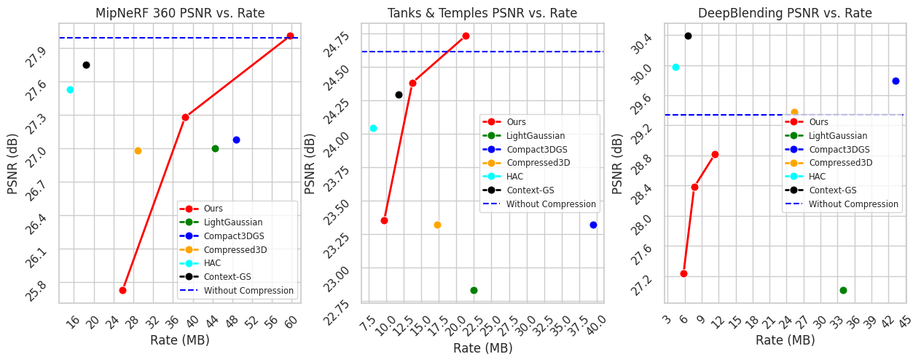
Learned entropy modeling yields competitive results
Notes:
Now continuing with our full approach including the pruning as well as learned entropy modeling, our model achieves a competitive rate-distortion performance.
Here in the graphs, we observe the performance of our approach at different bitrates where each point is trained for a different Lagrangian.
On all datasets, our approach is superior or on par to 3 other approaches, namely LightGaussian, Compact3DGS, and Compressed3D while two other approaches, HAC and Context-GS are superior to our method.
That is mainly because they build on a different Gaussian splatting framework called Scaffold-GS, allowing for a latent representation and further use of spatial correlation among Gaussians. They also use learned entropy models but on this different splatting framework.
Furthermore, we observe that our model has a degraded result on DeepBlending dataset which is because our optimization method with Markov Chain Monte Carlo framework achieves inferior results when compared to base Gaussian splatting. This inferiority is further boosted when compression is applied.

Slide 32
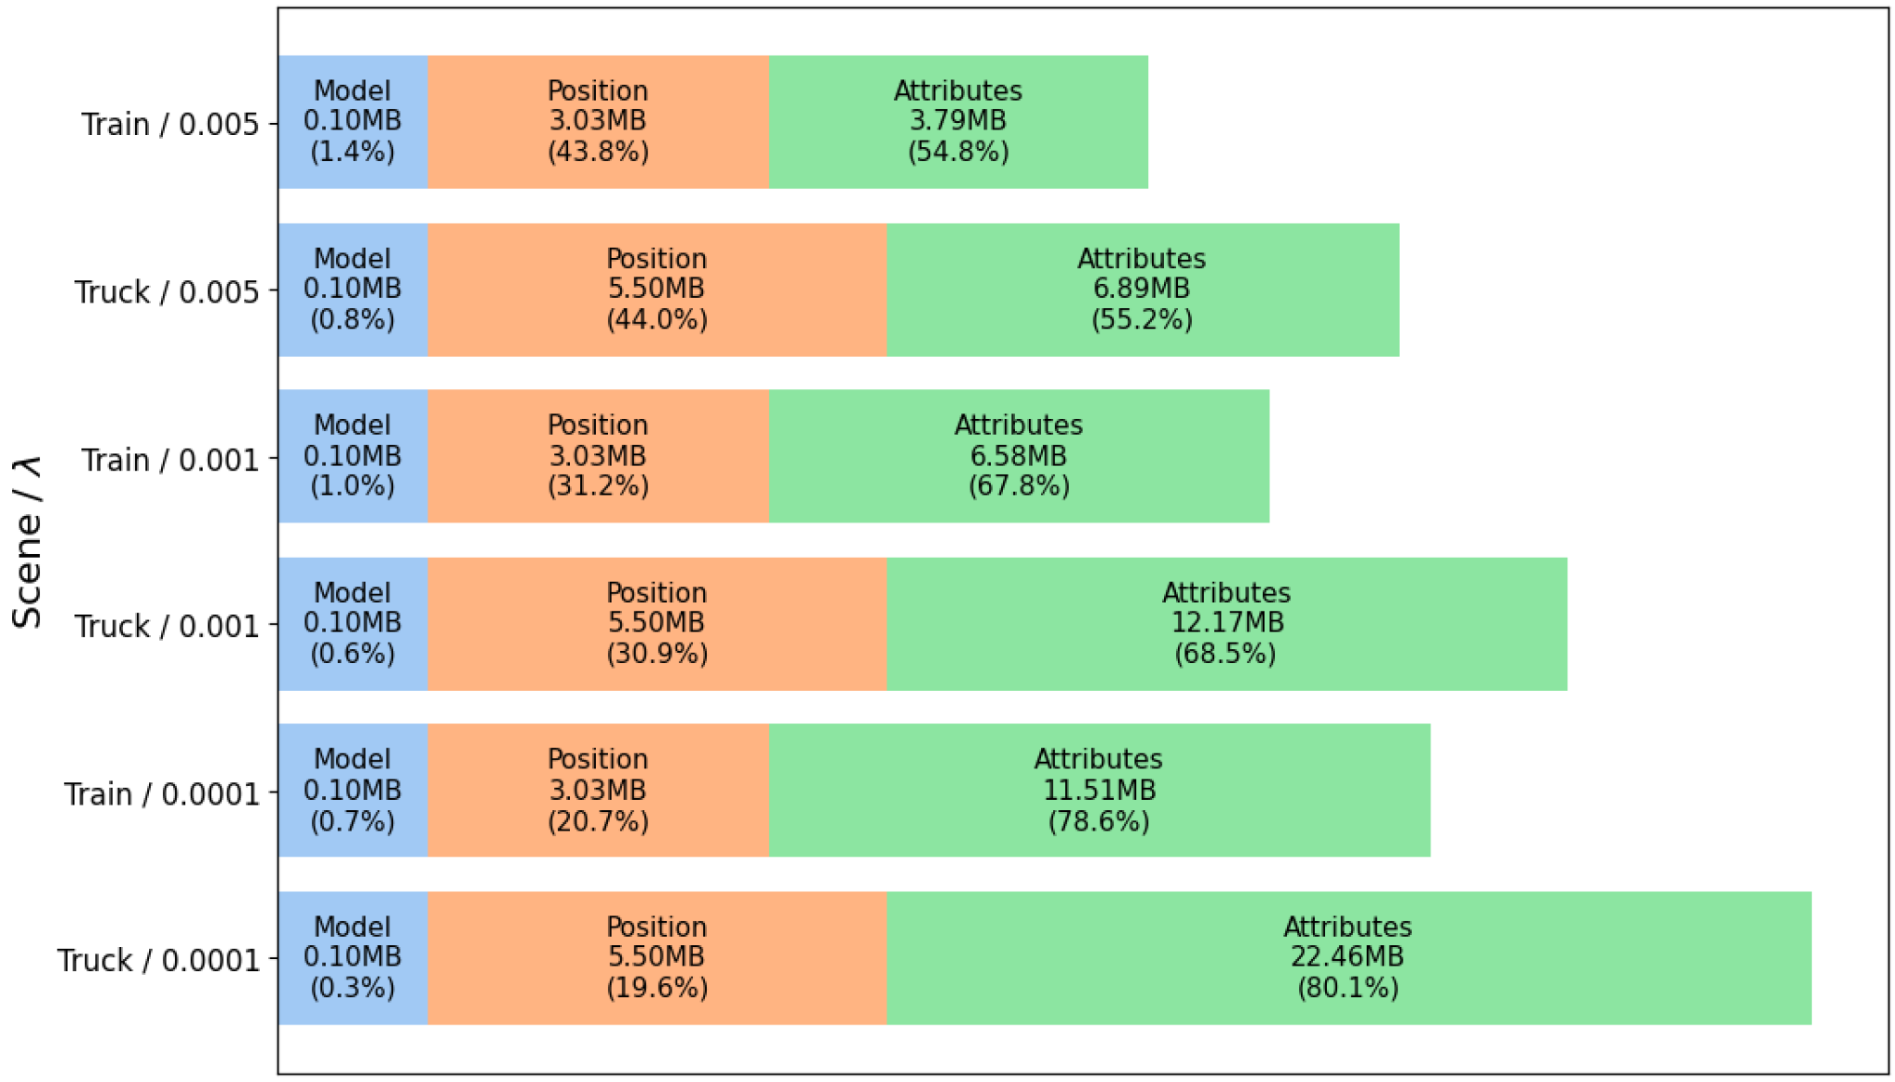
Gaussian parameters are significantly compressed
3 scalars
56 scalars
❗️Position information is a
relatively small component
but less compressible
compared to rest of
parameters
Notes:
We additionally compare the size distribution of compressed representation. On y-axis we see two scenes from tanks & temples dataset with different number of Gaussians and at different rate-distortion trade-offs depicted by lambda. The higher the lambda, the lower the size of compressed representation.
The primary change with different lambda is attributes size since we only compress the scaling, rotation, opacity and spherical harmonics with learned compression model.
When we compare the size distribution of the compressed representation, we can see that position information takes a significant portion of the representation which is not ideal since it is essentially a tiny part of all components.
However, our finding in terms of sensitivity of position information prevented us from using learned compression but that would remain as a future work.

Slide 33
Learned scales indicate Gaussian attribute importance
To prevent over-distorting important attributes of Gaussians, we scale them before quantization
Scaled attribute magnitudes serve as an indicator of attribute importance
Notes:
In addition, we inspect the learned scales that are used as analysis and synthesis transforms as they manage the quantization noise injected during lossy compression. When a scale parameter is set too high for a parameter, this indicates that the model is learning to induce lower amount of noise to the attribute since quantization performs rounding on the attribute.
For that reason, we inspect the scaled attribute magnitudes to understand the importance of each attribute for rasterization.

Slide 34
Learned scales indicate Gaussian attribute importance
1. Scaling parameters
are very important
3. Rotation angle is a
more important
component compared to
axis of rotation
2. Higher order spherical harmonics
are mostly redundant
Notes:
Here we see the absolute value of each attribute after scaling. A larger absolute value translates into lower noise in attribute during quantization and a higher relative importance.
When comparing the absolute scale of each Gaussian attribute, the first important observation is that the scaling parameters are very important for Gaussians. This is also confirmed by our experiments when we tried optimizing the Gaussian geometry attributes together with the learned entropy model. Due to the high importance of scaling parameters, the learned entropy model applies a larger scale to scaling parameters and reduces the quantization noise on them.
Second observation is that the higher order spherical harmonics coefficients are mostly redundant. This observation is also aligning with other works in the literature. Most of the Gaussians can be perfectly represented with just a base color while only a few requires view dependency.
Finally, we observe that the most important component of the quaternion representation of rotation is the rotation angle which is represented with the first scalar in quaternion.The axis of rotation might be less important as the rotation angle can make up for the errors in the axis of rotation by just tweaking single scalar.

Slide 35
Our additional experiment is jointly optimizing for multiple bitrates
Instead of training for single rate-distortion trade-off, we train for 4 trade-off points at once
During training, randomly same one trade-off point and scaling parameter at each iteration
All models share the same entropy model except the scale parameters
❗️Use 4 different 𝝀 = { 𝝀₁, 𝝀₂, 𝝀₃, 𝝀₄ } each associated
with a different scale S = { s₁, s₂, s₃, s₄ }
Notes:
As an additional experiment, we implemented an idea from image compression literature to achieve multiple bitrates corresponding to different rate-distortion trade-offs with a single training run.
For that reason, we train for 4 different rate-distortion trade-off points at once. This approach can help in terms of parameter-efficiency and reducing training time by 4 fold.
During training, we randomly select one of those trade-off points and its corresponding scaling parameter and use those values for the forward-pass and loss calculation. As a result, the scaling parameters achieve different values for different rate-distortion tradeoff parameters and we can use all those values during inference.
During inference, this method also allows for exponential interpolation among scale vectors so that we can also achieve intermediate bitrates

Slide 36
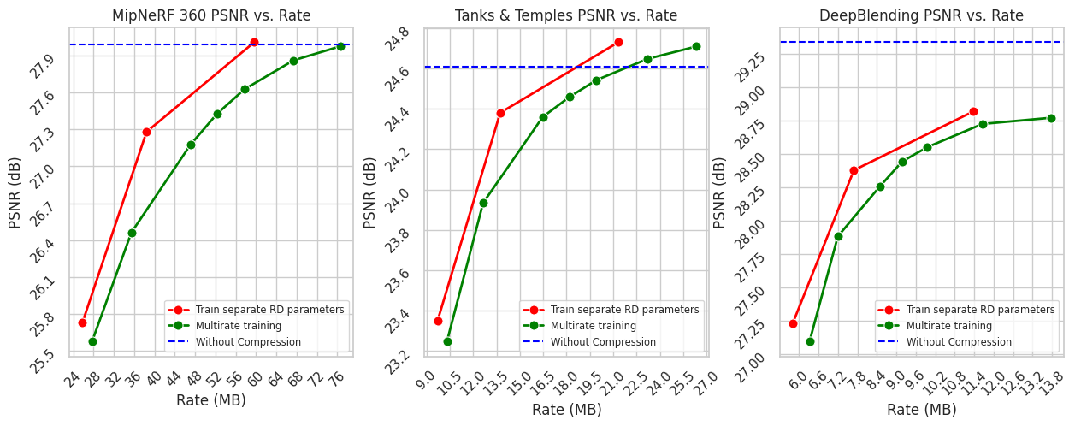
Multi-rate adaptation reduces training time
Exponentially interpolated
Notes:
Finally, we evaluate the results we acquire when using the multi-rate adaptation described in methods. Here we learn 4 different scale vectors for 4 different rate distortion trade-offs and build our rate-distortion curve using these scale vectors.
Although the multi-rate adaptation can help with parameter-efficiency and reducing the learned entropy model training time by a large margin, we observe a quality degradation in terms of rate-distortion performance.
However, now, we are also able to achieve intermediate bitrates at no cost as well

Slide 37
💯 Key Takeaways
Pruning based on Gaussian contributions is an effective way of reducing both computation and storage complexity at a negligible cost
Only using learned entropy models can show competitive results while:
Least compression-sensitive attribute is spherical harmonics
Most compression-sensitive attributes are position and scaling
Multi-rate entropy models are computation- and parameter-efficient but further research is required to reduce degradation
Further methods can help to use the correlation among Gaussians
Notes:
To conclude, we observe that the pruning method we adopted can effectively reduce the number of Gaussians and impose no significant cost in terms of visual quality or computation.
Furthermore, learned entropy modeling is capable of achieving quite competitive results in terms of rate-distortion performance without the ad-hoc methods employed by other works in the literature.
The method we adopt is also very easy to integrate with widely adopted Gaussian splatting applications since the backbone of Gaussian splatting is integrable with our method in contrast to some other works in the literature.
And we observe that the spherical harmonics are quite insensitive to compression especially for higher order coefficients while position and scaling parameters are very sensitive to quantization noise.
In addition, the multi-rate entropy models show promising results with little degradation in rate-distortion performance but also allowing for high gains in terms of training time and parameter-efficiency.
Finally, we observe that further methods can help to increase the computation efficiency by utilizing the correlation among Gaussians as shown with other superior methods in literature.

Slide 38
Thank you for listening ❗️
Any questions ❓

